Slide 2
Data visualization in Python
Cindy van de Vries – Safavi Nic & Dave de Koning

Slide 3
Type of plots
Time series
Spatial maps
2D graphs
Categorical plots
Bar charts
Longitudinal charts

Slide 4
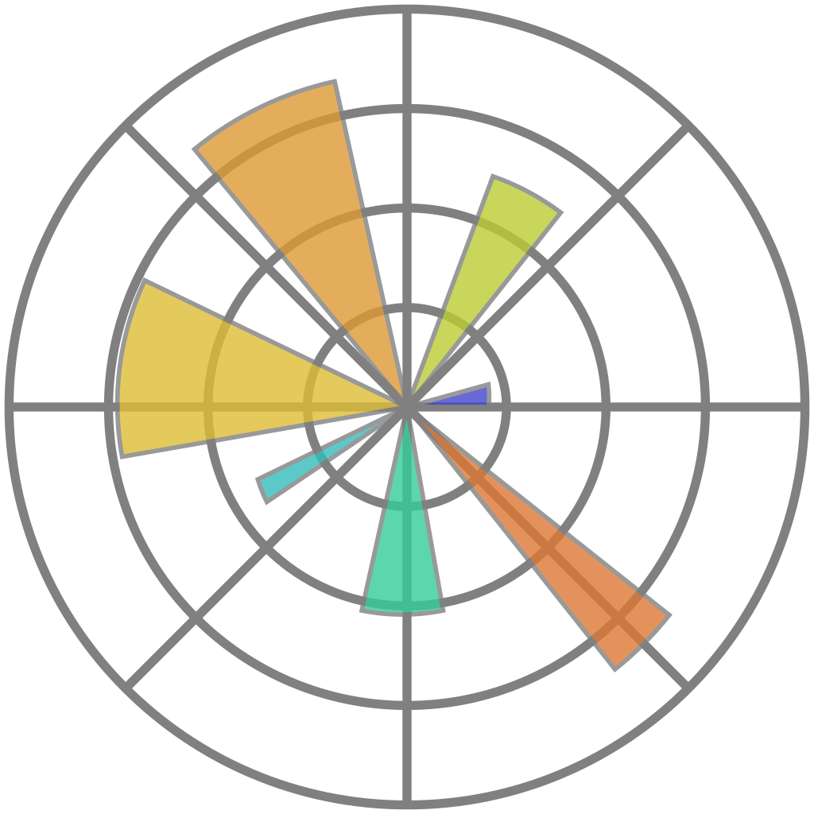

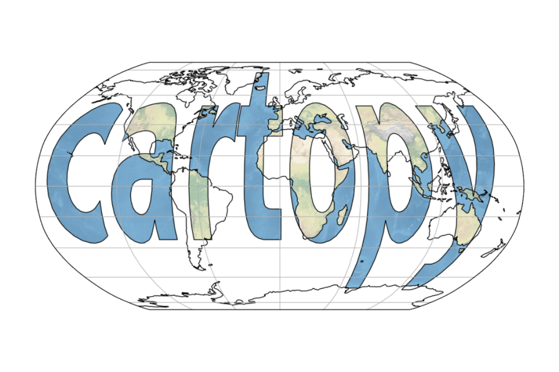


Packages
Matplotlib
Bokeh
Seaborn
ggplot
Cartopy
Altair
Holoviews
Plotly

Slide 5
Ways of plotting

Slide 6
Basic plot

Slide 7
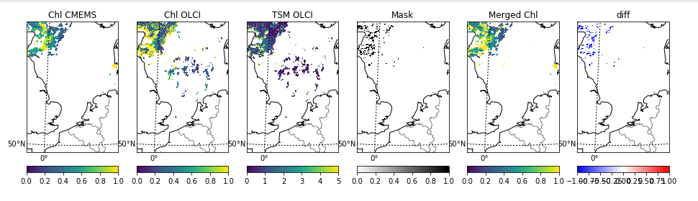

Slide 8
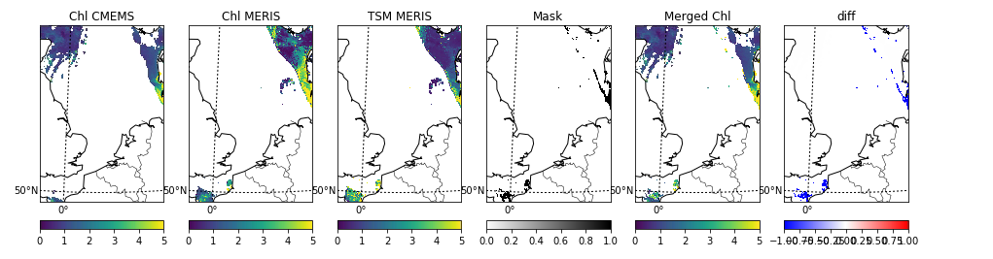

Slide 9
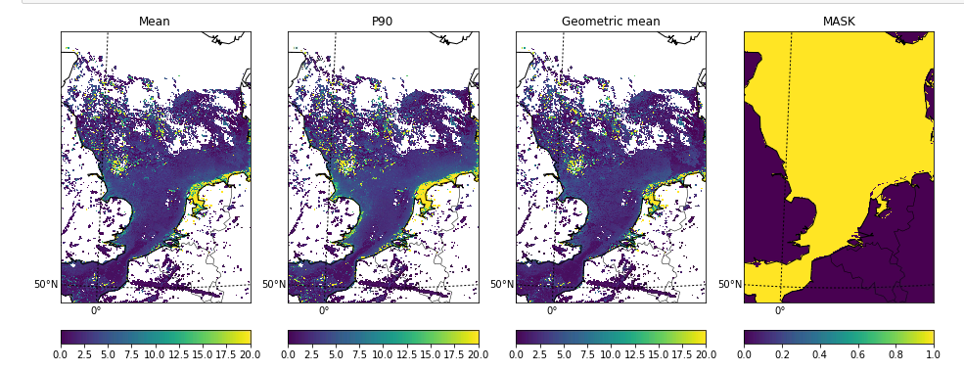

Slide 10
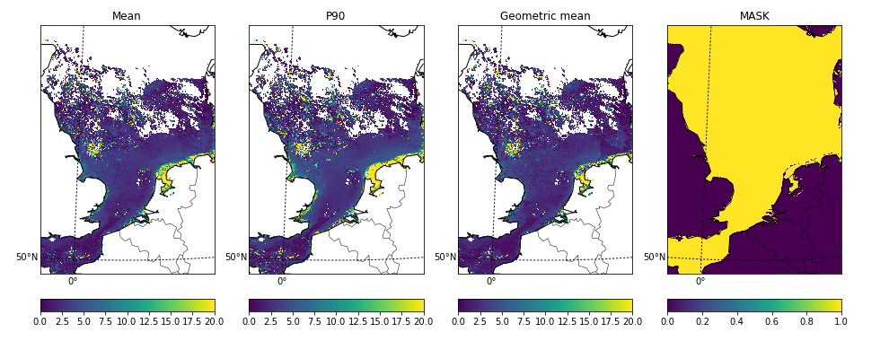

Slide 11
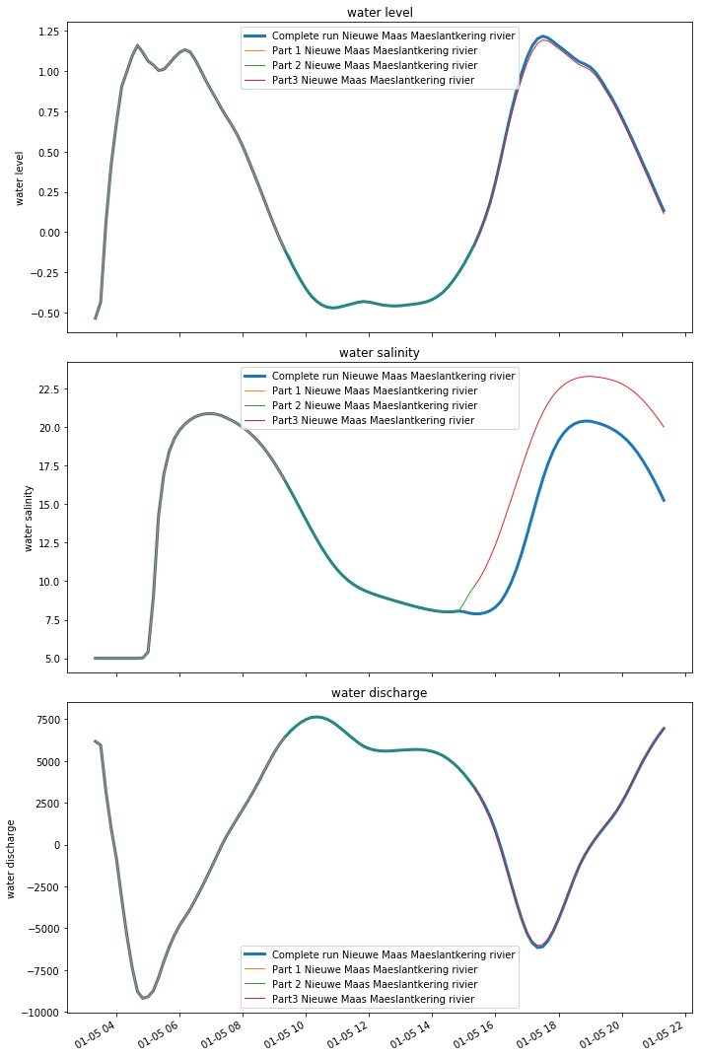

Slide 12
